Slide 1
draft-ietf-sidr-rpki-validation-reconsidered
G. Huston
G. Michaelson
APNIC
C. Martinez
LACNIC
T. Bruijnzeels
RIPE NCC
A. Newton
ARIN
A. Aina
AFRINIC

Slide 2
Have you read the draft?
Yes?
No?
Read the draft
Review the following slides
Discuss

Slide 3
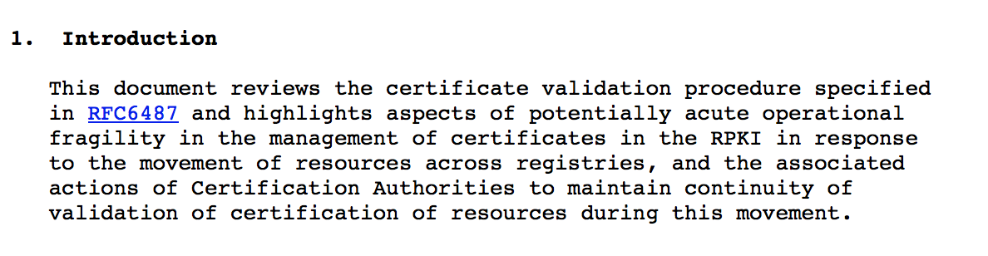

Slide 4
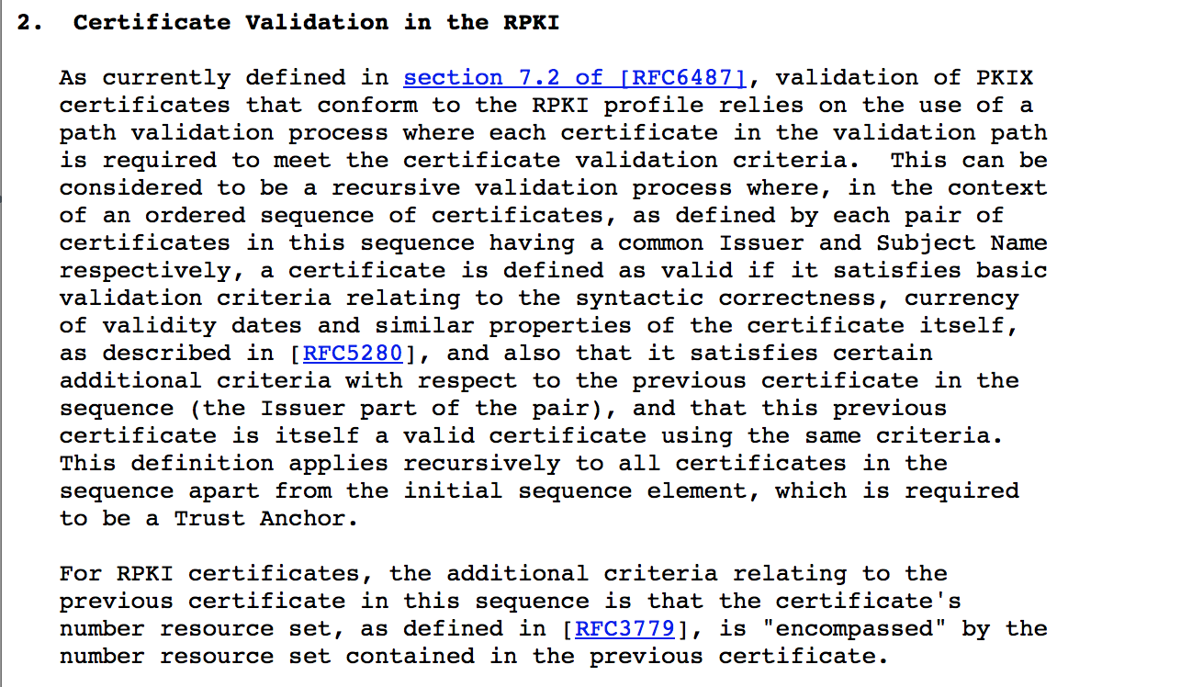

Slide 5
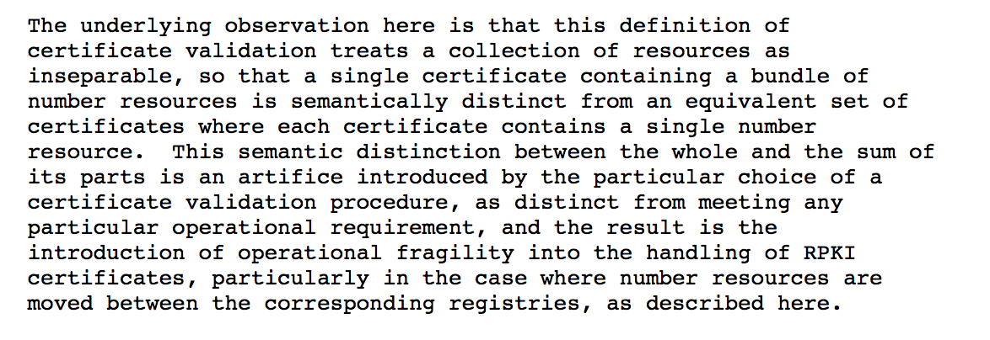

Slide 6
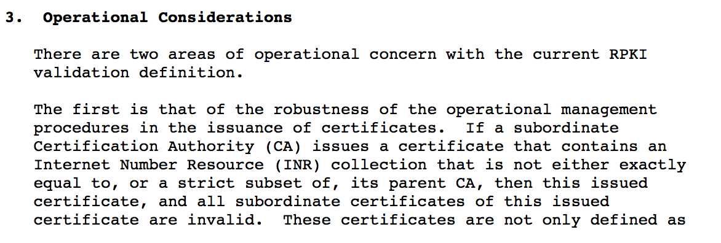
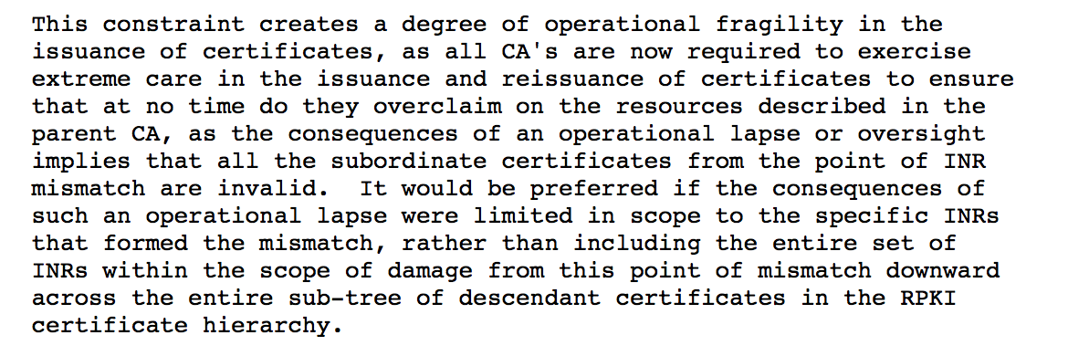
…

Slide 7
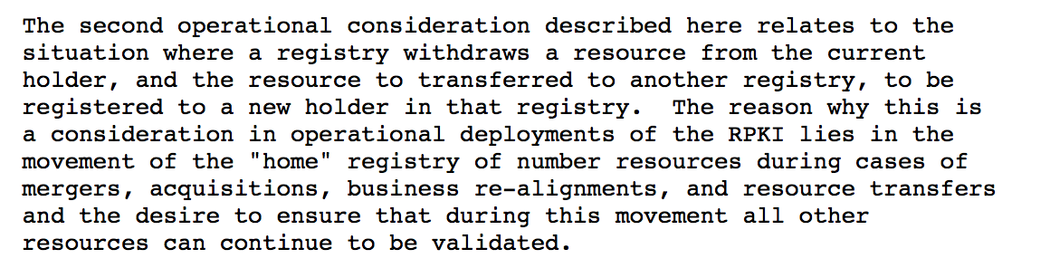
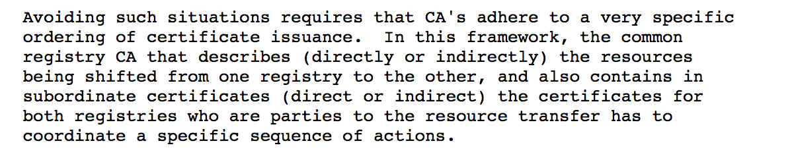
…

Slide 8
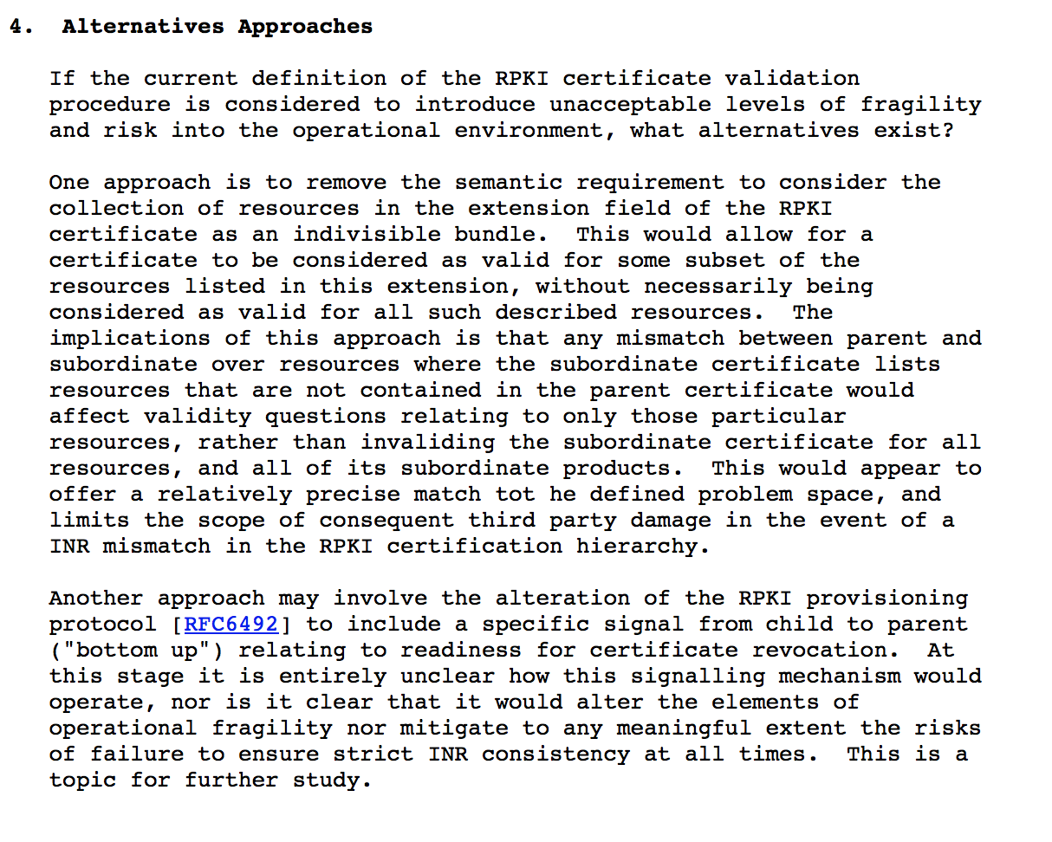

Slide 9
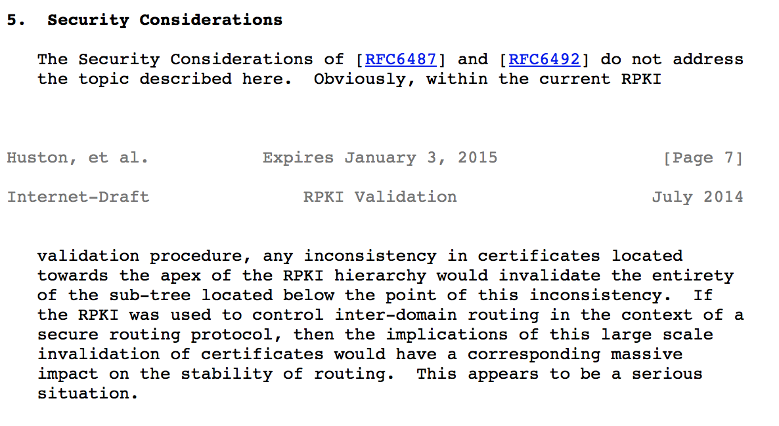

Slide 10
Discuss

